Slide 1

Cholo: A Campus Ride Sharing Solution
Tanmoy Kumar Das
ID - 2102079
This report outlines the "Cholo" project, a revolutionary app designed to streamline transportation for university students, addressing common commute challenges and fostering a more connected campus community.

Slide 2





The Campus Commute Conundrum
Excess Free Capacity
High Commuting Costs
Fragmented Community
Many students commute with personal bikes or cars, often having one or more empty seats. This unused capacity represents an inefficient use of resources.
Students without personal transport rely on services like Pathao or Uber, which can be expensive, adding financial burden to their academic life.
The lack of a centralized ride-sharing system limits interaction and community building among students from different departments or backgrounds.

Slide 3




Cholo: The Innovative Solution
Cholo is a mobile application specifically tailored for university students, creating a peer-to-peer ride-sharing network that benefits both drivers and passengers.
Account Creation
Route & Time Matching
Students create secure accounts, verified with their student ID, ensuring a trusted user base.
Drivers can post available seats with their route and time, while passengers can search for rides based on their destination and schedule.
Seamless Booking
Cost-Effective Rides
If a match is found, passengers can instantly book a seat through the app, simplifying the coordination process.
Ride costs are set at half the price of commercial services like Pathao or Uber, making it highly affordable.

Slide 4

Mutual Benefits for the Cholo Community
For Student Drivers
Drivers earn supplementary income by utilizing their otherwise empty seats, covering fuel costs or daily expenses.
For Student Passengers
Passengers enjoy significantly reduced commute costs (40% less than commercial apps) and reliable transportation.
For Cholo Developers
The project generates revenue through a 10% commission on each ride, ensuring sustainability and future development.

Slide 5



Technology Stack
Cholo is built with robust and scalable technologies to ensure a smooth and reliable user experience.
Flutter
Android Studio
MongoDB
For cross-platform mobile app development, ensuring a consistent user interface and experience on both Android and iOS.
The integrated development environment for robust Android app development and debugging, leveraging native capabilities.
A NoSQL database chosen for its flexibility and scalability, ideal for managing dynamic user data and ride information.

Slide 6
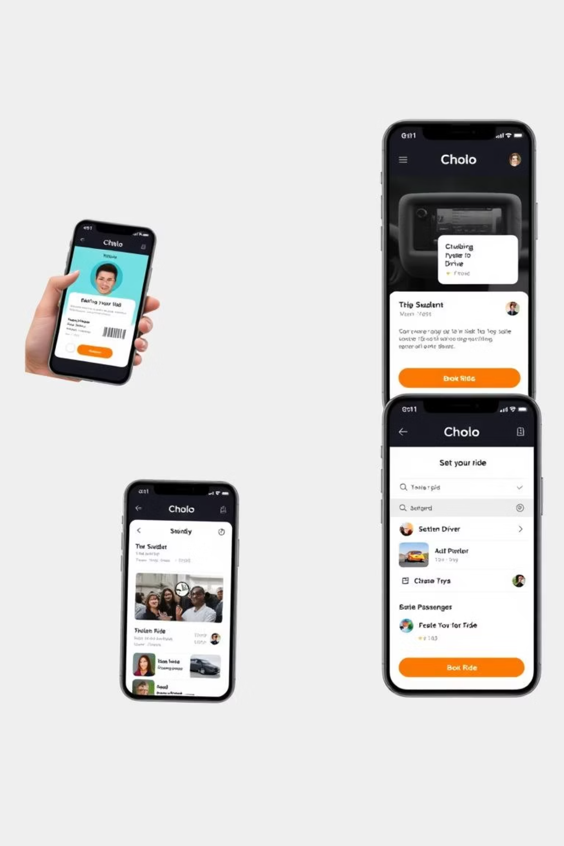
Methodology: Ensuring Trust and Efficiency
1
Student ID Verification
Only university students can create accounts, ensuring a secure and trusted community through mandatory student ID verification.
2
Driver Ride Settings
Drivers have the option to set up a ride by specifying their exact route, departure time, and available seats.
3
Passenger Ride Search
Passengers can efficiently search for available rides based on their desired route and time, viewing matching options.
4
Seamless Ride Booking
Once a suitable ride is found, passengers can instantly book a seat within the app, confirming their spot.

Slide 7

Market Opportunity and Impact
Cholo taps into a significant unmet need within university communities, offering an economically viable and environmentally friendly alternative to traditional transport.
By fostering direct connections, it also aims to enhance campus connectivity and reduce traffic congestion around universities.
Drivers
Passengers
The platform has strong potential for growth and expansion to other university campuses, creating a widespread network.
The pie chart illustrates the projected user distribution, with a larger segment of students benefiting as passengers.

Slide 8



Conclusion: A Win-Win-Win Proposition
The Cholo app promises a highly beneficial solution for all stakeholders, addressing critical pain points in student transportation
Student Empowerment
Students gain affordable, convenient transport and an opportunity to earn from their commutes.
Economic Sustainability
A clear revenue model (10% commission) ensures the project's long-term viability and growth.
Community & Environment
Fosters a stronger campus community while contributing to reduced carbon emissions.

